Slide 1
Student Attendance Management System
Cloud-Based Serverless Web Application using AWS
Semester Project – AWS-Based Implementation
Instructor: Prof. Zunnurain Hussain
Student Name: Usman Farooq
Roll No: BSSE23062

Slide 2

Executive Summary: A Digital Transformation
The Student Attendance Management System is a robust cloud-based web application designed to automate and digitize attendance management across educational institutions. This system eliminates traditional manual processes, ushering in an era of efficiency.
Key Benefits with AWS
High Scalability
Robust Security
High Availability
It features role-based dashboards for students, teachers, and administrators, offering real-time attendance tracking, comprehensive reporting, and automated alerts.
Cost Efficiency

Slide 3

Introduction & The Problem with Manual Systems
Traditional attendance systems often rely on manual methods—paper registers or spreadsheets—which are inherently time-consuming, prone to human error, and generally inefficient. These outdated processes hinder productivity and data accuracy within academic environments.
We identified several critical issues:
Time Consumption:
Inaccuracy:
Lack of Transparency:
Reporting Challenges:
A secure, automated, and cloud-based solution is essential to overcome these challenges and modernize attendance tracking.

Slide 4



Aim & Strategic Objectives
Our Aim
Key Objectives
To design and implement a secure, scalable, and serverless student attendance management system leveraging the power of AWS cloud services.
Provide role-based access for all users.
Enable real-time attendance storage and retrieval.
Automate alerts and notifications.
Ensure data security using AWS IAM.
Achieve high availability via serverless architecture.

Slide 5

System Overview: Tailored User Roles
Students
Teachers
Administrators
View class schedules and attendance percentages.
Efficiently mark and update daily attendance.
Manage users and class rosters.
Generate comprehensive attendance reports.
Receive automated alerts for attendance shortages.
Access class-wise attendance summaries instantly.
Monitor overall system activity and performance.

Slide 6

AWS Architecture Diagram
Frontend
S3 static site served via CloudFront
API Management
API Gateway routes client requests
Business Logic
Lambda functions handle processing
Data Storage
DynamoDB stores application data
Monitoring
CloudWatch collects metrics and logs

Slide 7
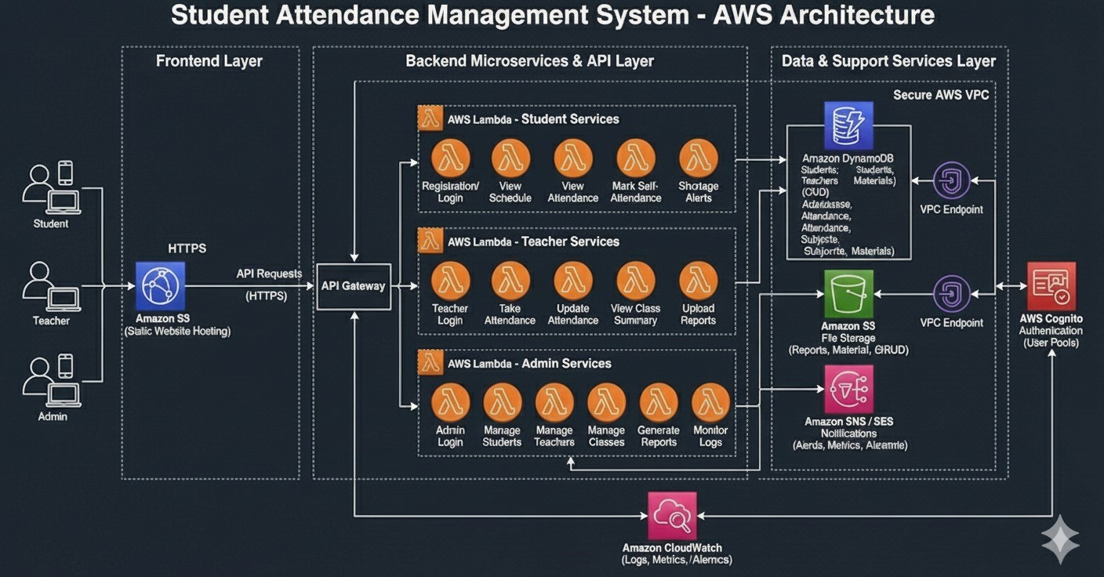

Slide 8

Core AWS Services Utilized
Amazon S3
CloudFront
AWS Lambda
Static website hosting for the frontend application files.
Fast and secure content delivery network (CDN) for enhanced performance.
Serverless compute service for executing backend business logic without managing servers.
API Gateway
DynamoDB
AWS IAM
Securely manages and publishes APIs for communication between frontend and backend.
High-performance NoSQL database for storing all attendance and user data.
Manages user identities and permissions, ensuring robust role-based access control.
CloudWatch
Monitors resources and applications, providing logs, metrics, and alarms.

Slide 9
Implementation Steps: Building the System
01
02
03
AWS Account Configuration & IAM
DynamoDB Table Creation
AWS Lambda Development
Set up the AWS account and establish appropriate IAM roles with least-privilege permissions.
Design and create necessary DynamoDB tables for efficient storage of attendance records, user profiles, and class data.
Develop and deploy serverless AWS Lambda functions to handle all core business logic and data processing.
04
05
06
API Gateway Integration
Frontend Deployment on S3
Testing & Workflow Validation
Integrate Lambda functions with API Gateway to create secure and scalable API endpoints for frontend interaction.
Deploy the web application's static frontend files to Amazon S3, configured for public access via CloudFront.
Thoroughly test all APIs and the entire application workflow to ensure functionality and data integrity.
07
CloudWatch Monitoring
Set up Amazon CloudWatch for continuous monitoring of logs and metrics, ensuring optimal performance and proactive issue detection.

Slide 10

Security, Monitoring & Achieved Results
Robust Security Measures
IAM Roles:
API Access:
Data Encryption:
Proactive Monitoring
CloudWatch:
Alerts:
Tangible Results
Real-time Visibility:
Reduced Workload:
Accurate Reporting:

Slide 11

Conclusion
The Student Attendance Management System successfully delivers an efficient, secure, and highly scalable solution for modern attendance tracking in educational settings.
By fully leveraging the AWS serverless architecture, this system significantly improves accuracy, transparency, and operational efficiency. It effectively minimizes infrastructure management overhead and substantially reduces operational costs.
Our project demonstrates a forward-thinking approach to educational technology, offering a robust platform that meets the evolving demands of academic institutions.

